Slide 1
Software Project Management (SPM) Unit- V
Prepared by: Neha Tripathi

Slide 2
SPM
Software Configuration Management
(SCM)

Slide 3
Introduction
The results (also called as the deliverables) of a large software development effort typically consist of a large number of objects, e.g. source code, design document, SRS document, test document, user’s manual, etc.
These objects are usually referred to and modified by a number of software engineers through out the life cycle of the software.
The state of all these objects at any point of time is called the configuration of the software product.
The state of each deliverable object changes a development progresses and also as bugs are detected and fixed.

Slide 4
Release vs. Version vs. Revision
A new version of a software is created when there is a significant change in functionality, technology, or the hardware it runs on, etc.
On the other hand a new revision of a software refers to minor bug fix in that software.
A new release is created if there is only a bug fix, minor enhancements to the functionality, usability, etc.

Slide 5
Necessity of software configuration management
Inconsistency problem when the objects are replicated.
Problems associated with concurrent access.
Providing a stable development environment.
System accounting and maintaining status information.
Handling variants.

Slide 6
Software configuration management activities
Configuration management is carried out through two principal activities:
- Configuration identification
It involves deciding which parts of the system should be kept track of.
- Configuration control
It ensures that changes to a system happen smoothly.
Notes:
Normally, a project manager performs the configuration management activity by
using an automated configuration management tool. A configuration
management tool provides automated support for overcoming all the problems
mentioned above. In addition, a configuration management tool helps to keep
track of various deliverable objects, so that the project manager can quickly and
unambiguously determine the current state of the project. The configuration
management tool enables the engineers to change the various components in a
controlled manner.

Slide 7
Configuration identification
Typical controllable objects include:
• Requirements specification document
• Design documents
• Tools used to build the system, such as compilers, linkers, lexical analyzers, parsers, etc.
• Source code for each module
• Test cases
• Problem reports
The configuration management plan is written during the project planning phase and it lists all controlled objects.

Slide 8
Configuration control
Configuration control is the process of managing changes to controlled objects. The configuration control system prevents unauthorized changes to any controlled objects.
In order to change a controlled object such as a module, a developer can get a private copy of the module by a reserve operation as shown in fig.
Configuration management tools allow only one person to reserve a module at a time. Once an object is reserved, it does not allow any one else to reserve this module until the reserved module is restored as shown in fig.
Thus, by preventing more than one engineer to simultaneously reserve a module, the problems associated with concurrent access are solved.

Slide 9
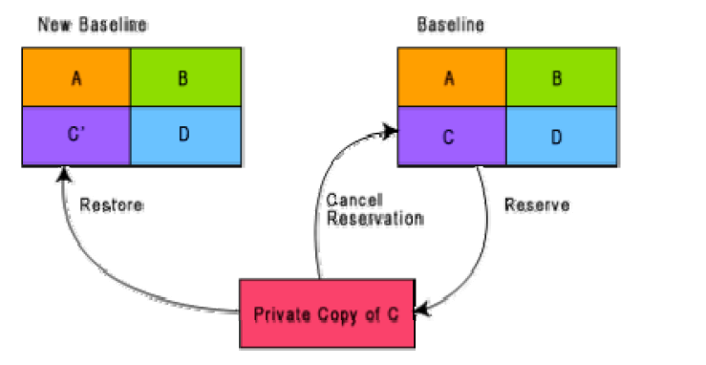
Reserve and restore operation in configuration control

Slide 10
Steps:
The engineer needing to change a module first obtains a private copy of the module through a reserve operation.
Then, he carries out all necessary changes on this private copy. However, restoring the changed module to the system configuration requires the permission of a change control board (CCB).
The CCB is usually constituted from among the development team members. For every change that needs to be carried out, the CCB reviews the changes made to the controlled object and certifies several things about the change:
1. Change is well-motivated.
2. Developer has considered and documented the effects of the change.
3. Changes interact well with the changes made by other developers.
4. Appropriate people (CCB) have validated the change, e.g. someone has tested the changed code, and has verified that the change is consistent with the requirement.

Slide 11
Continue…
The change control board (CCB) sounds like a group of people. However, except for very large projects, the functions of the change control board are normally discharged by the project manager himself or some senior member of the development team.
Once the CCB reviews the changes to the module, the project manager updates the old base line through a restore operation (as shown in fig.).
A configuration control tool does not allow a developer to replace an object he has reserved with his local copy unless he gets an authorization from the CCB. By constraining the developers’ ability to replace reserved objects, a stable environment is achieved.
Since a configuration management tool allows only one engineer to work on one module at any one time, problem of accidental overwriting is eliminated.
Also, since only the manager can update the baseline after the CCB approval, unintentional changes are eliminated.

